Slide 1
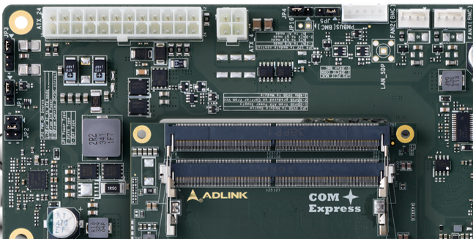
JP5
JP5 PCIE MUX
1-2 | PCIE CONN
2-3 | Run BMC

Slide 2
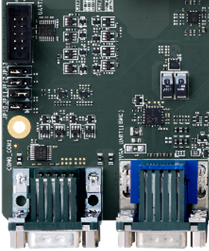
JP13
JP5 PCIE MUX
1-2 | PCIE CONN
2-3 | Run BMC
JP12
JP12/JP13 UART SOL Select
 | JP12 | JP13
SOL | 1-2 | 1-2
Module RS232 | 2-3 | 2-3

Slide 3
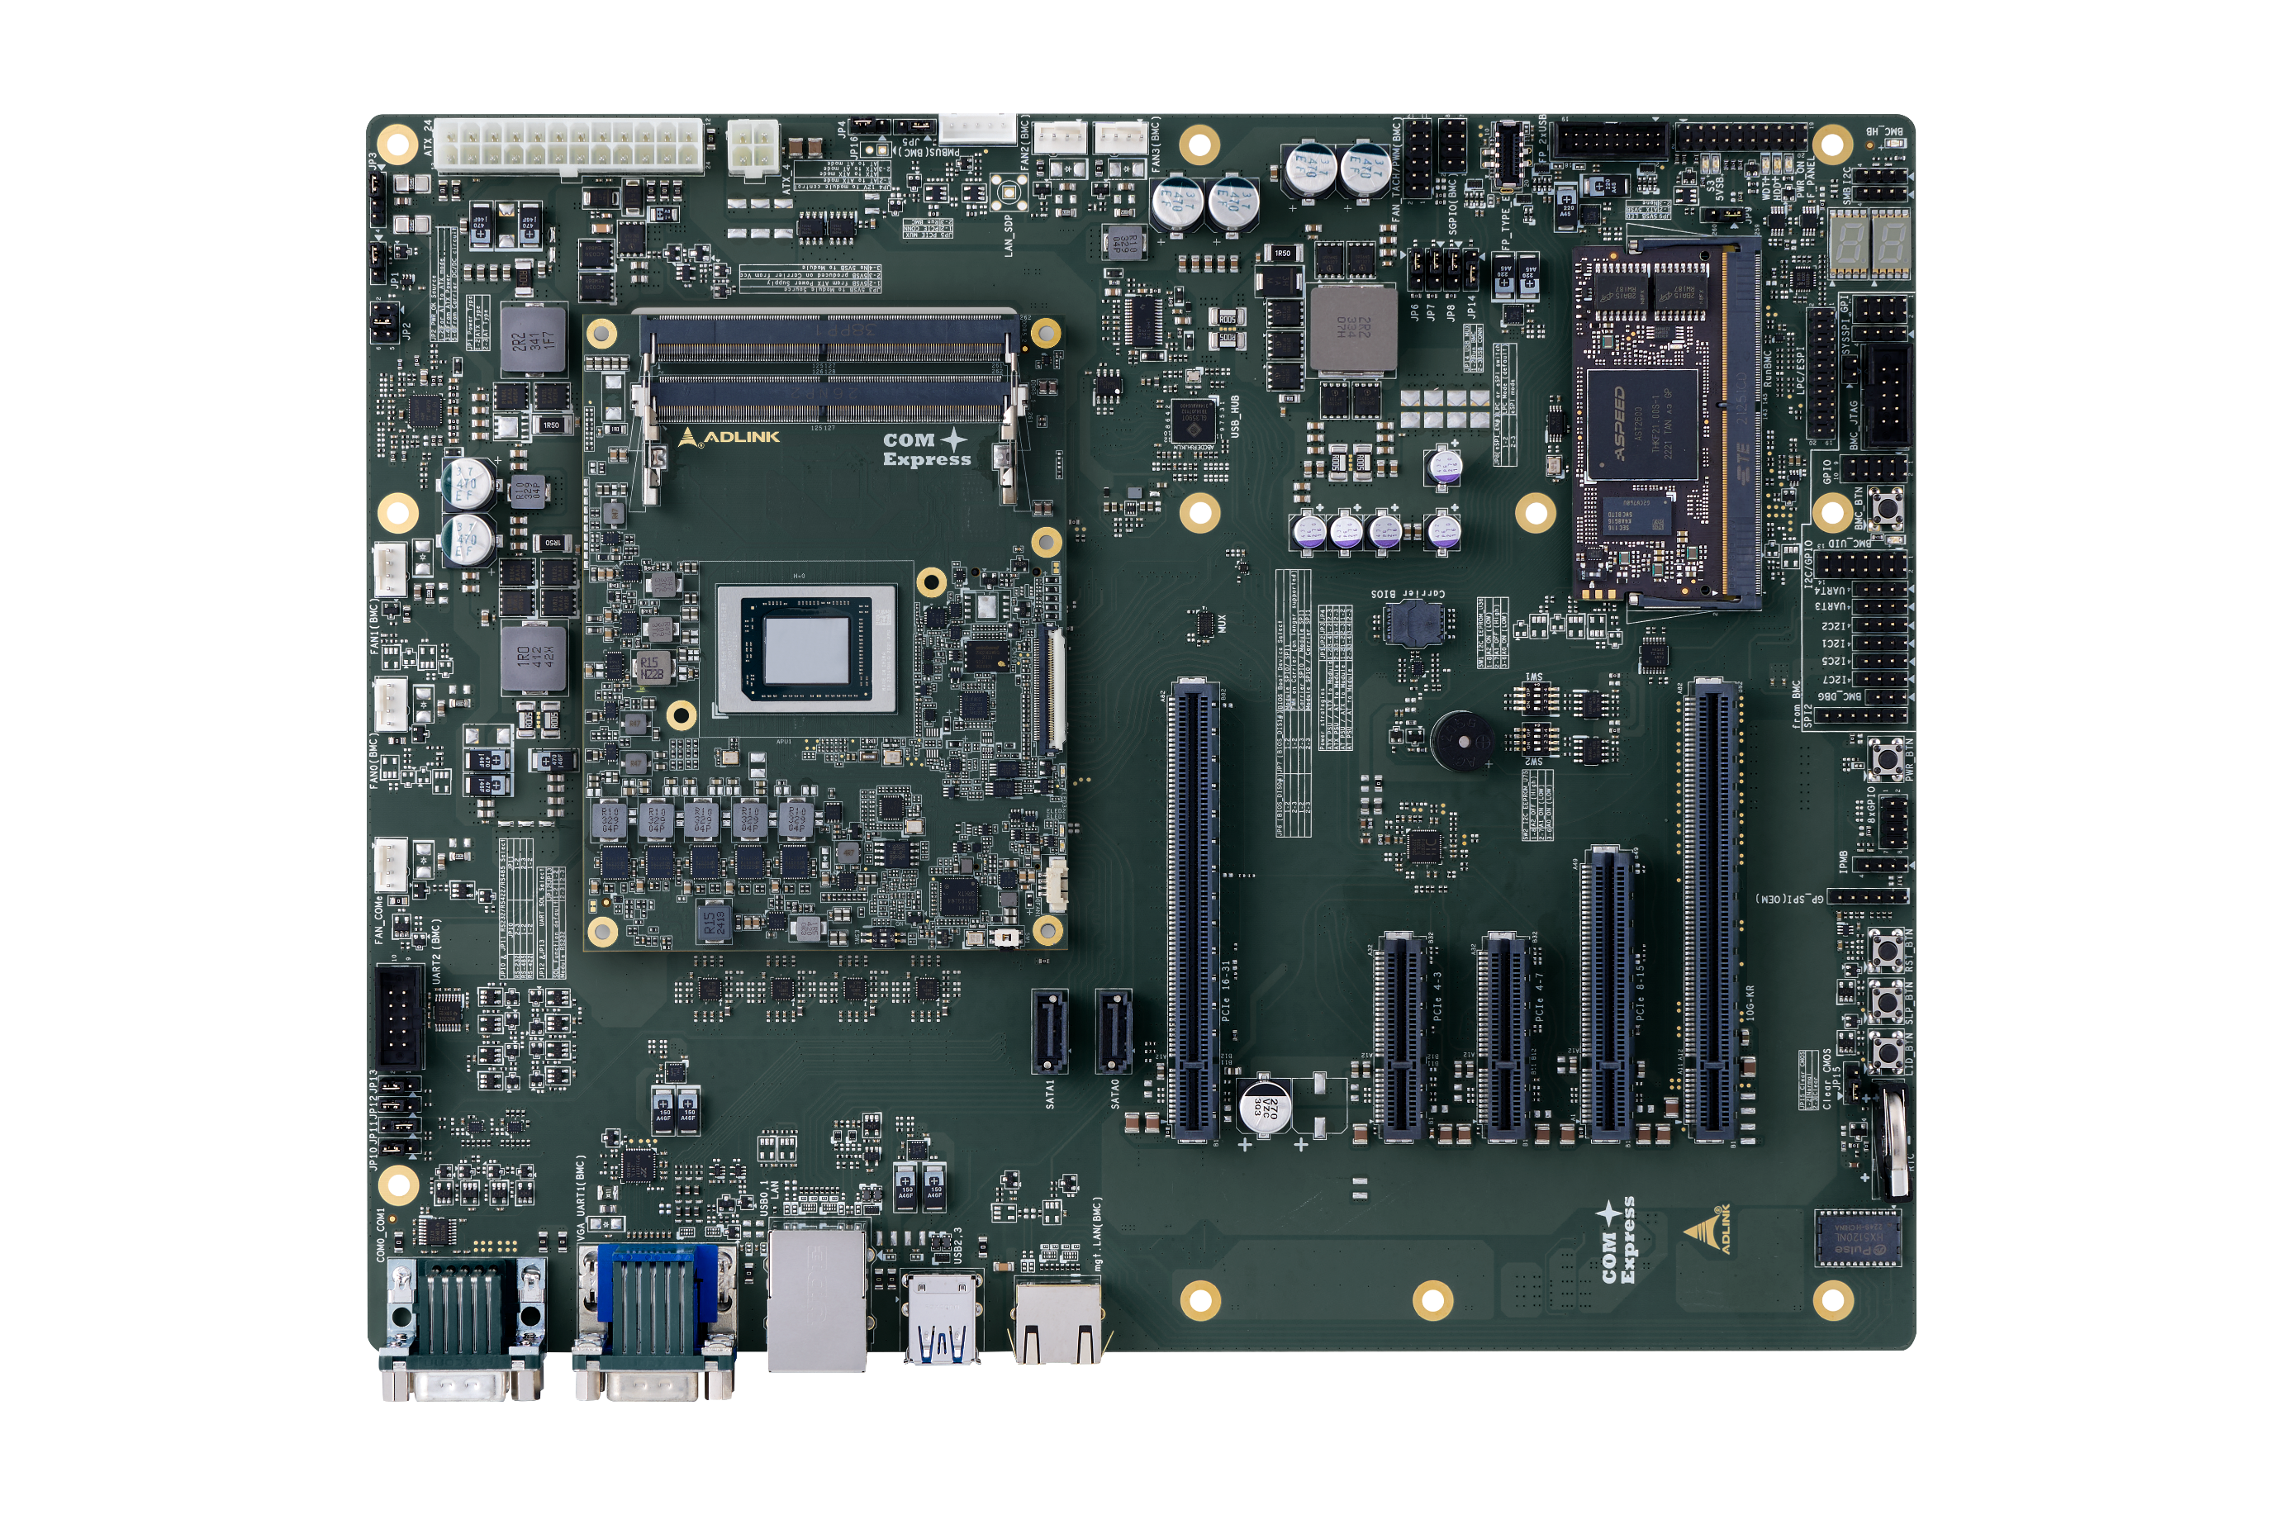
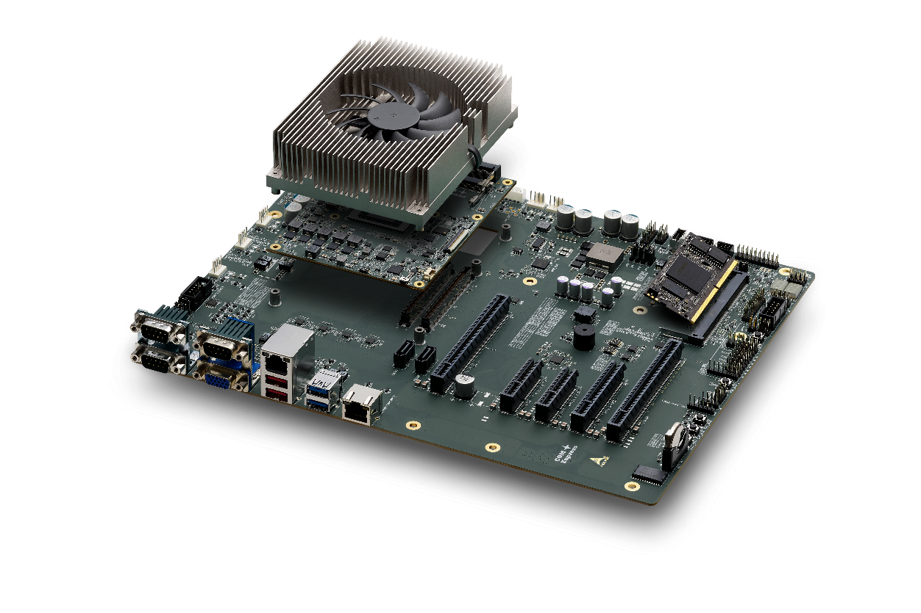

mgt.LAN
Client System
(remote)
Dev Kit
(AMD Ryzen V3000 CPU + AST2600 BMC)

Slide 4
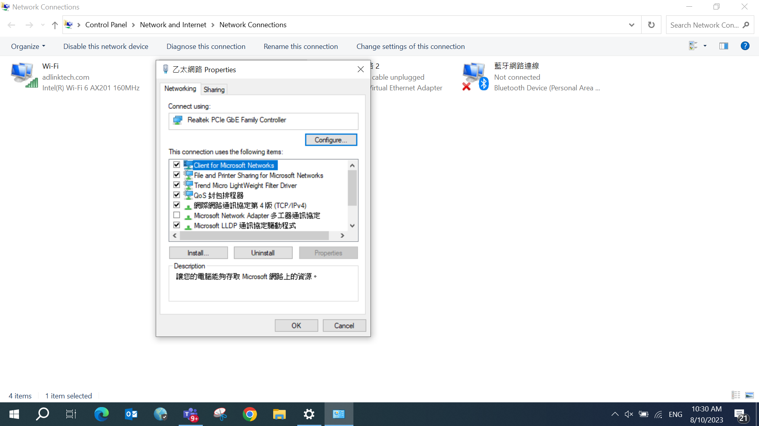

Slide 5
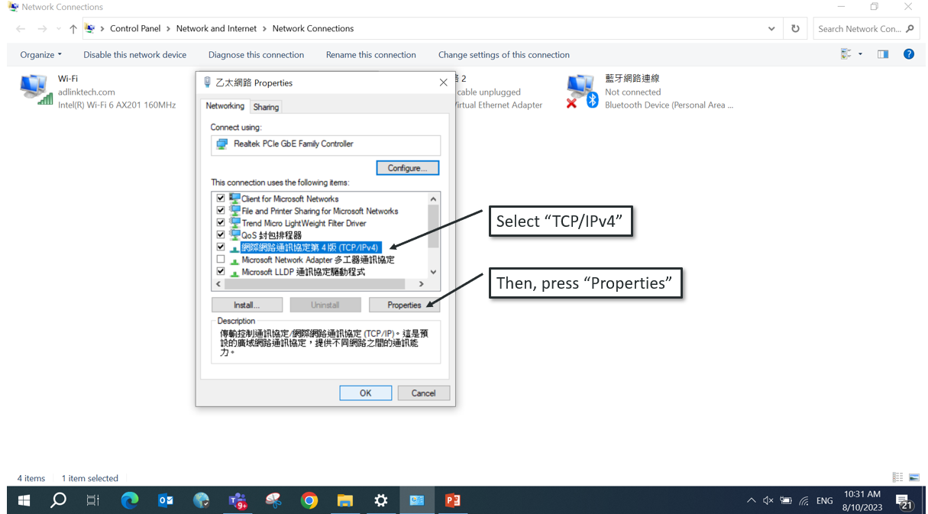

Slide 6
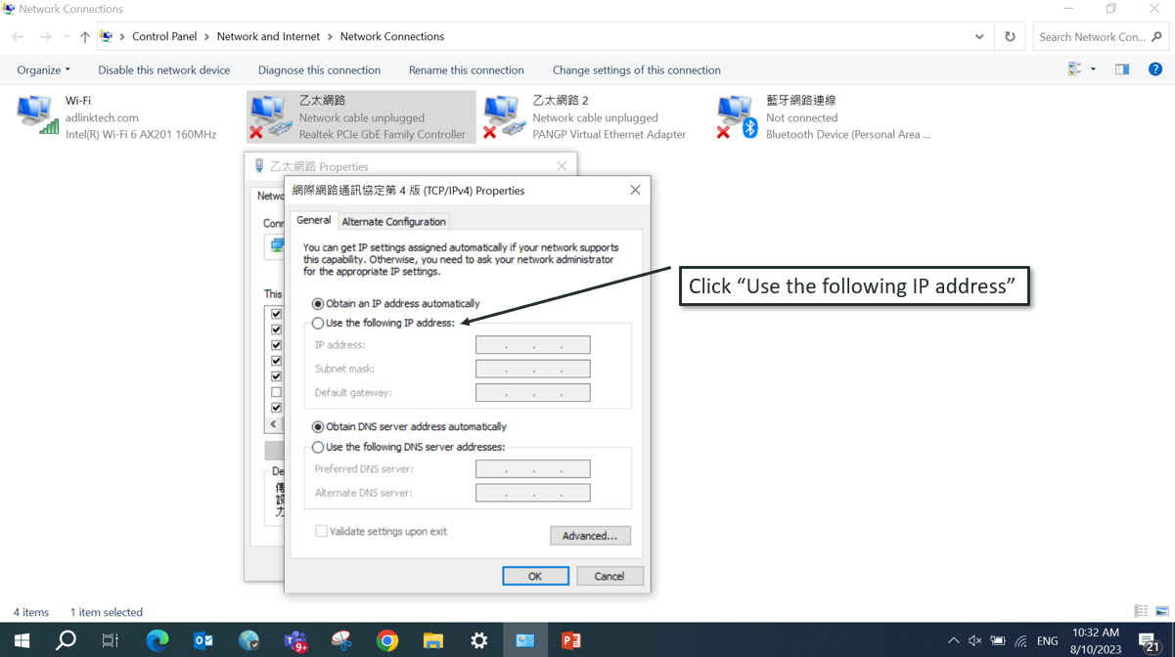

Slide 7
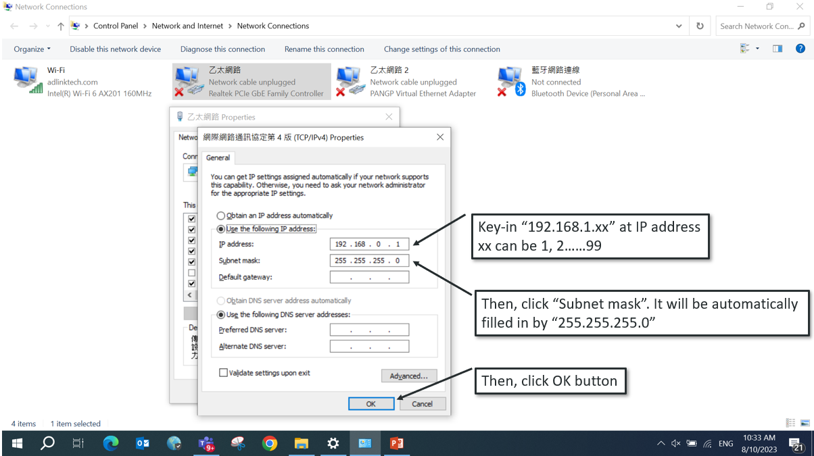

Slide 8
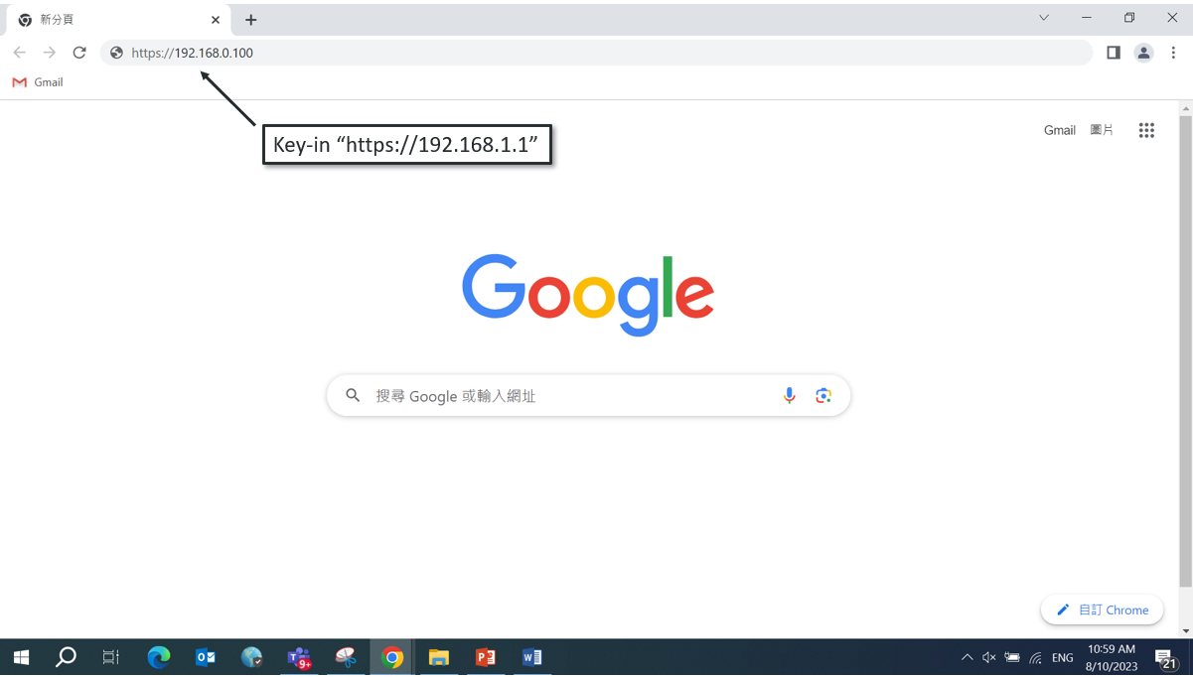
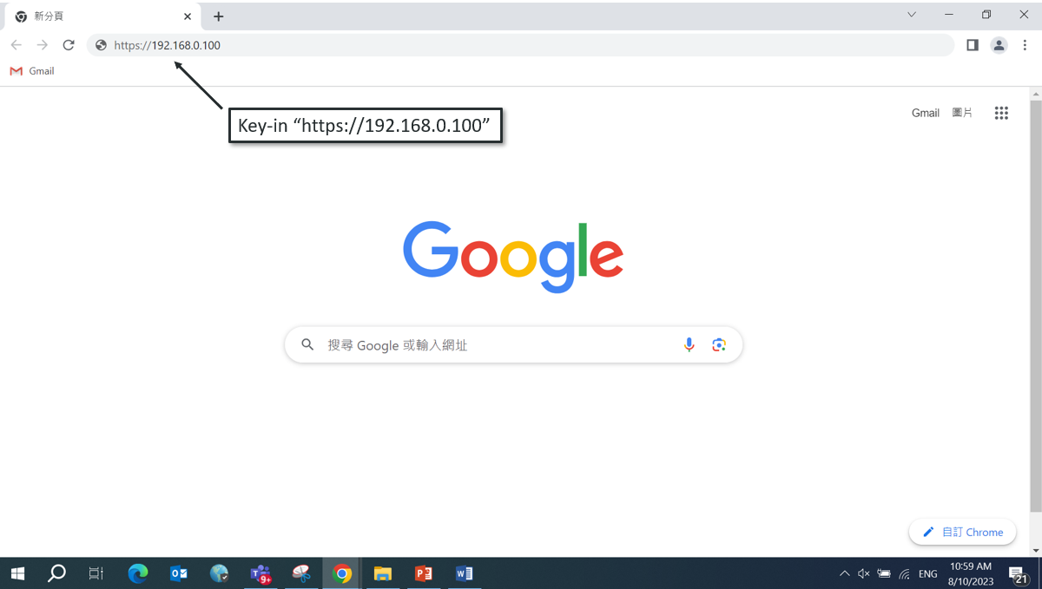
192.168.1.1

Slide 9
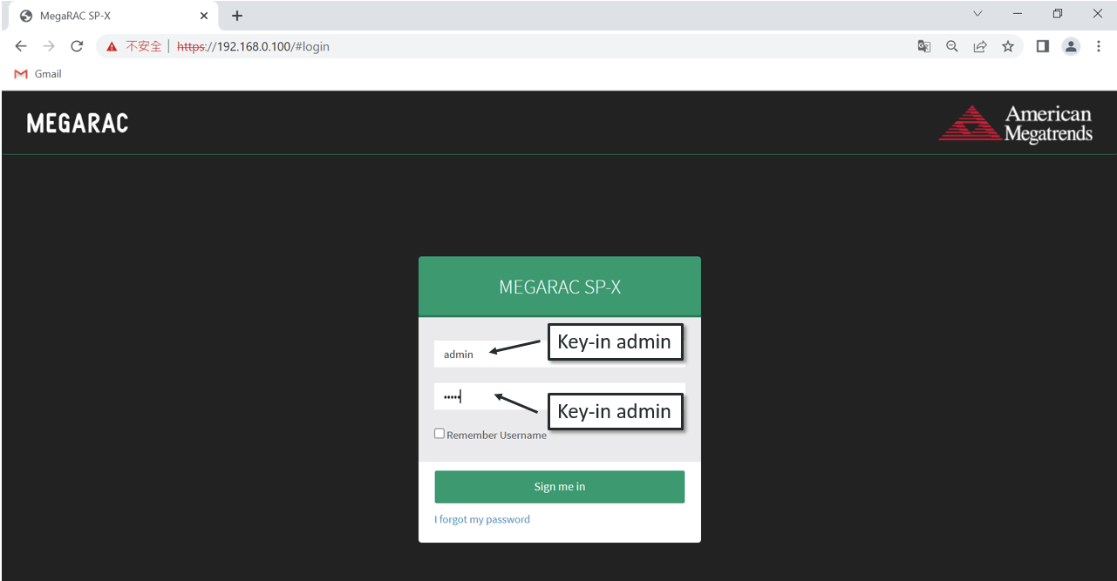

Slide 10
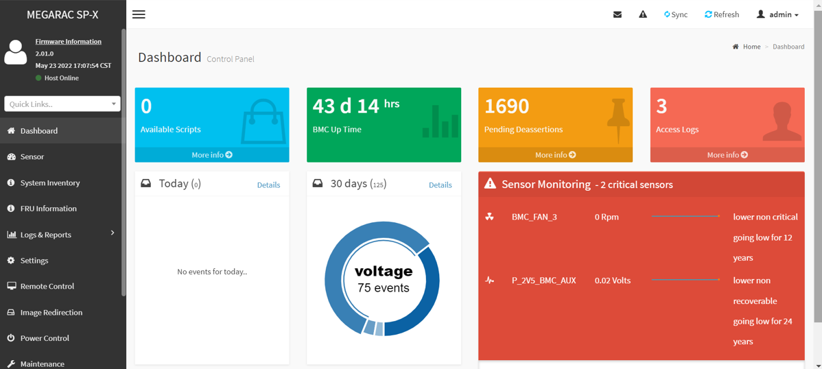

Slide 12
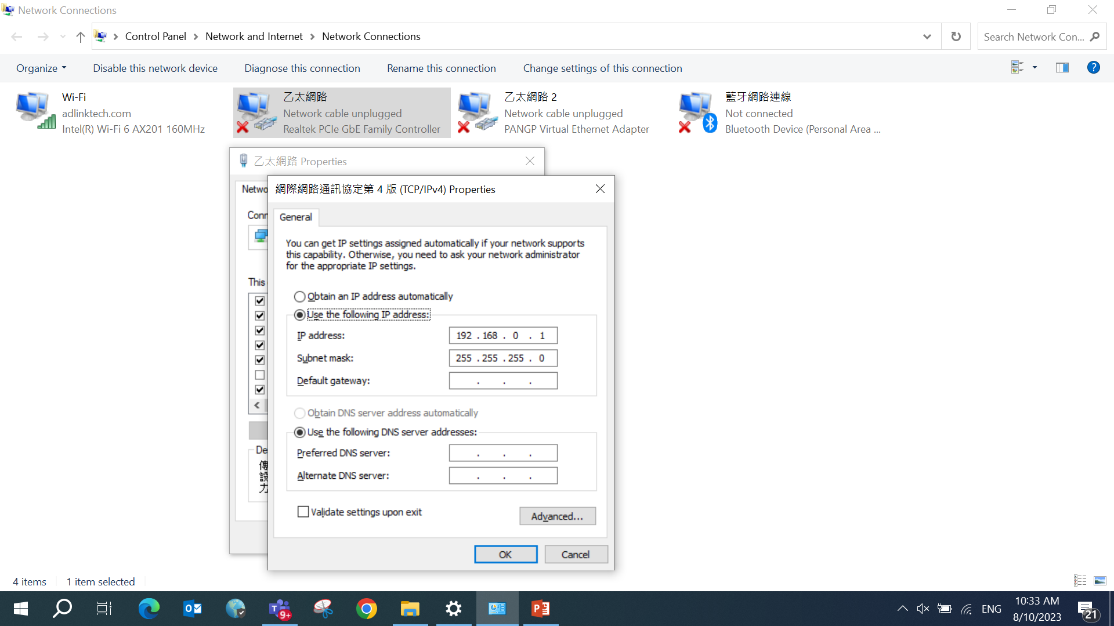
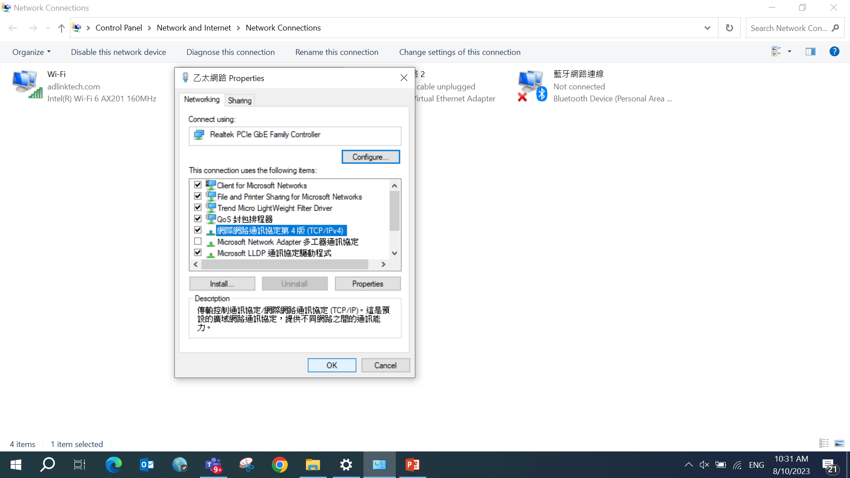
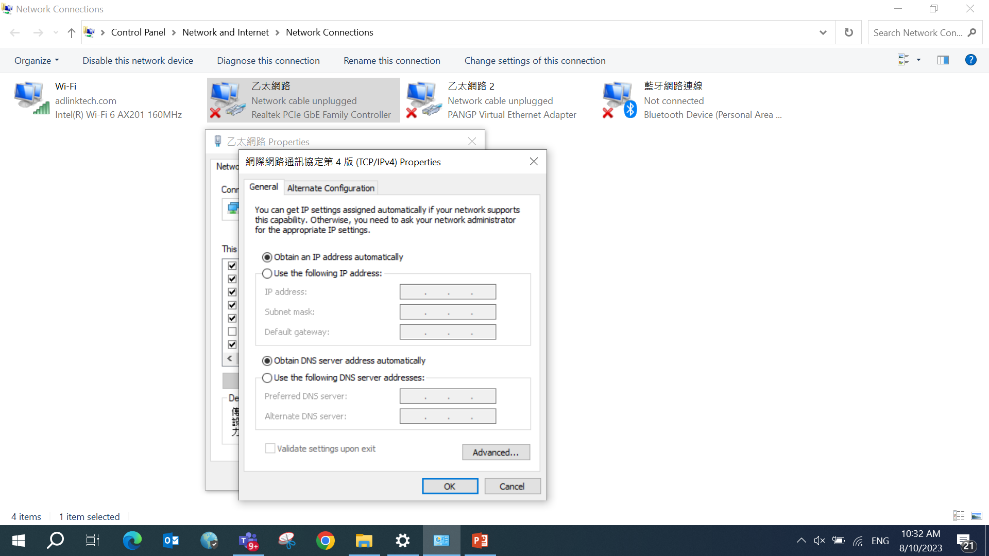
Key-in “192.168.1.xx” at IP address
xx can be 1, 2……99
Then, click “Subnet mask”. It will be automatically
filled in by “255.255.255.0”
Then, click OK button

Slide 13
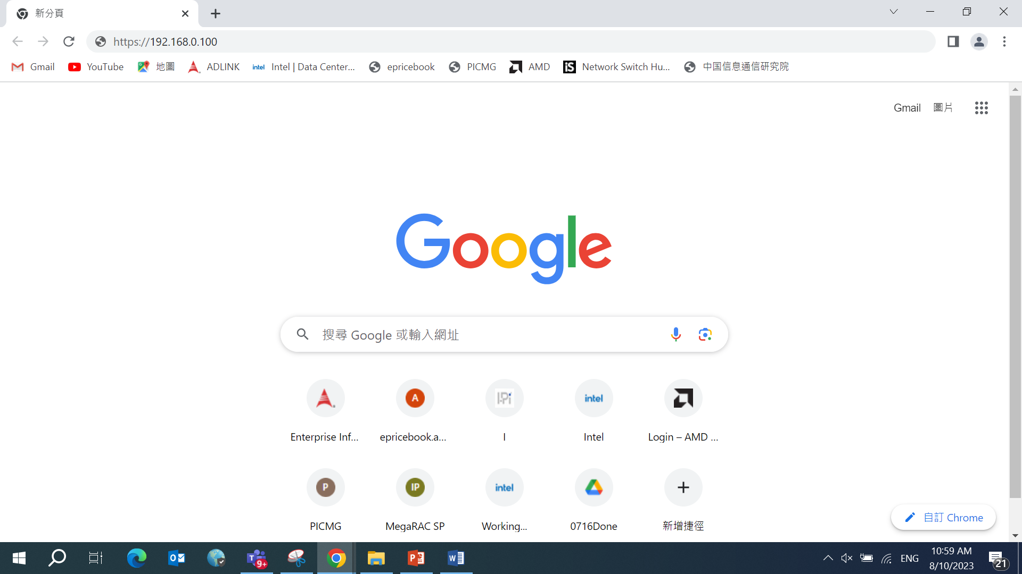
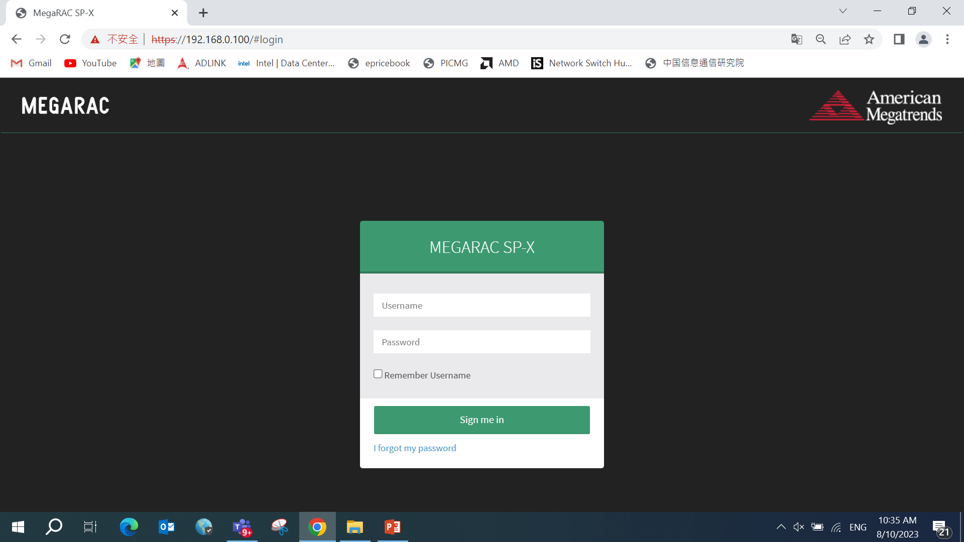
Key-in “https://192.168.1.1”

Slide 14

